Slide 1
The Effect of Climate on
Building Energy Consumption
Group Members:
Adam Keeling
Steven Kroman
Bobby Robles

Slide 2
Motivation & Hypothesis
Questions
Hypotheses
How does climate affect building energy use?
Are there differences between building types?
Why? Common interest among group
The climate will show an effect on building energy consumption.
Mild climates will show the least amount of energy consumption.
As climate becomes extreme, energy consumption will increase.
Notes:
Bobby:
Building energy use will increase as climate becomes more extreme, whether hot or cold, i.e. milder climates will have less energy intensive buildings.

Slide 3
Questions & Data
Questions
Kinds of Data
Data Sources
Does building energy use change by average, minimum, or maximum temperature, diurnal temperature range, by climate zone, or by building use type?
Building energy use
By location (city, state, climate zone, zip code)
By building type (residential, commercial, etc.)
Weather history, averages, degree days or climate classification
Department of Energy’s Building Performance Database API
National Oceanic and Atmospheric Administration - National Centers for Environmental Information API
Notes:
Bobby:
Adam: Mention NOAA

Slide 4
Data Cleanup & Exploration
Insights while exploring
Problems that arose
Data cleanup
Learning new terms in order to properly use data
(EUI = Energy Use Intensity)
Most weather APIs charged for historical data.
Cities in BPD listed just city name, while weather data was City, State US.
Weather data requests required data range. Makes sense for hourly, daily, or yearly, but not “normals” yet still had to enter a specific arbitrary date as parameter.
Some cities had bogus data of obvious outliers (e.g. -7777)
Building energy data was only available as aggregated, not individual buildings so only means, medians, quartiles, etc. not lists.
Notes:
Adam:
Steven:

Slide 5
Data Analysis Steps
Scatter Plots by City
Bar Plots by Climate Zone
Separate energy types
Combined building data with climate data and ran scatter plots correlating different weather characteristics to energy use.
The DOE already has broken up the US by similar climates into climate zones.
Whole building EUIs did not correlate well with temperature. However since Heating is mostly done by a Fuel and Cooling is mostly done using Electricity, we split the EUI.
Notes:
Adam:

Slide 6
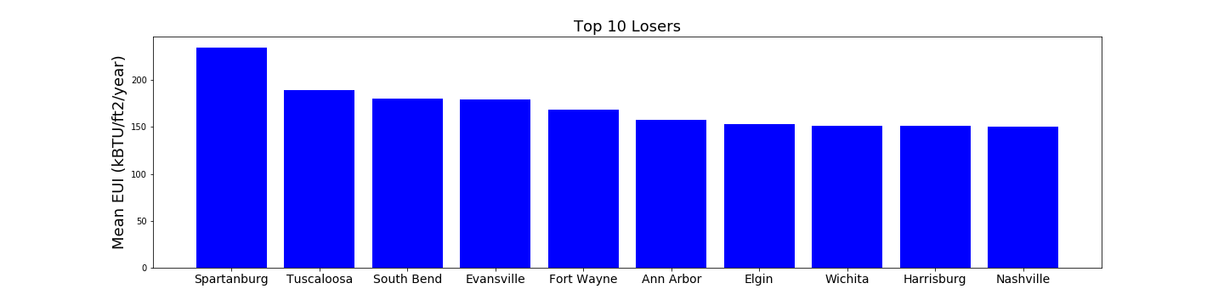
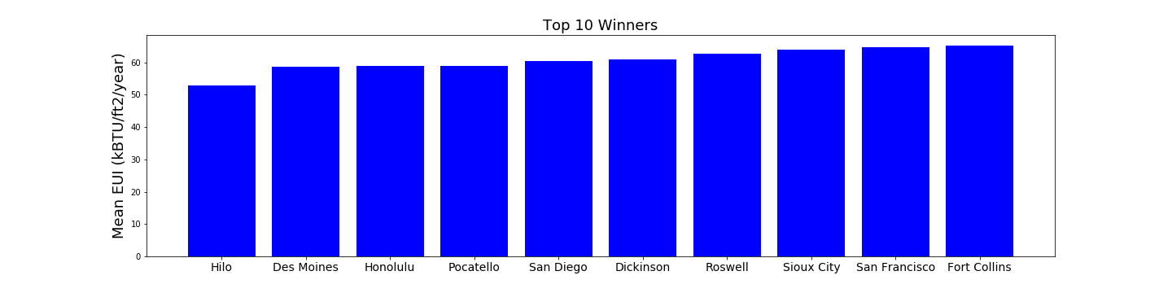
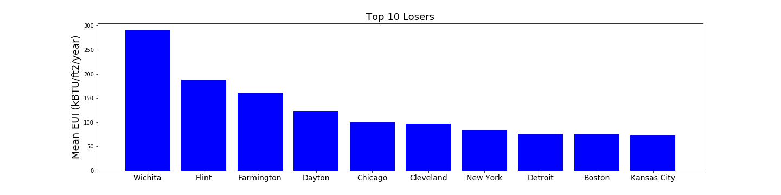
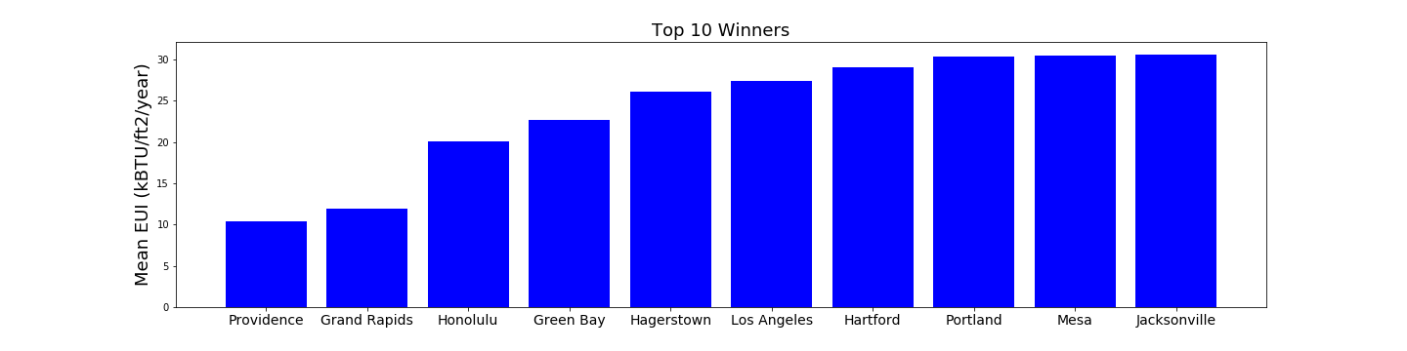
Top 10
Bottom 10
Commercial Buildings
Residential Buildings
Notes:
Bobby:

Slide 7
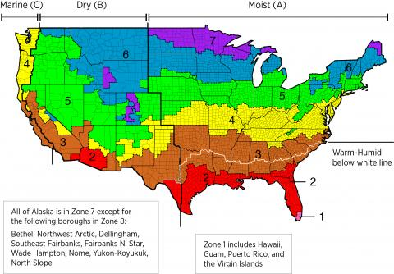
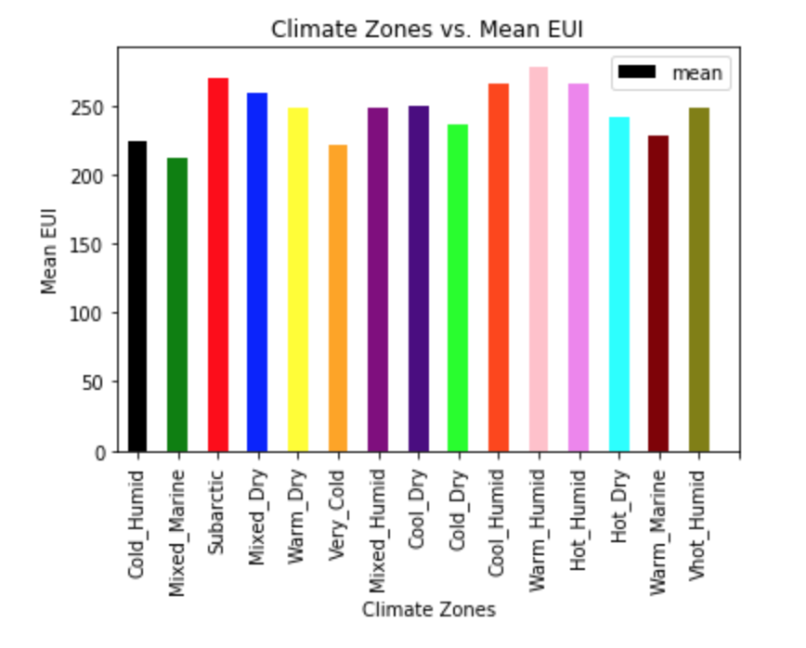
DOE Climate Zones
Notes:
Bobby:

Slide 8
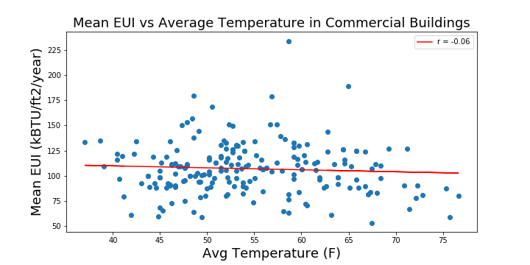
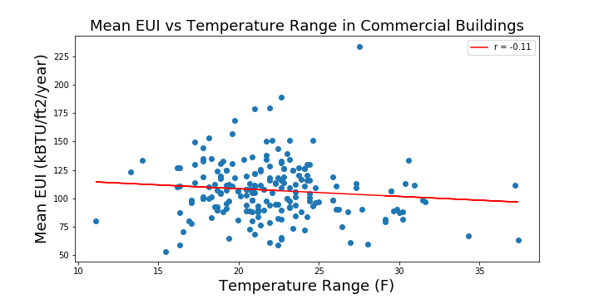
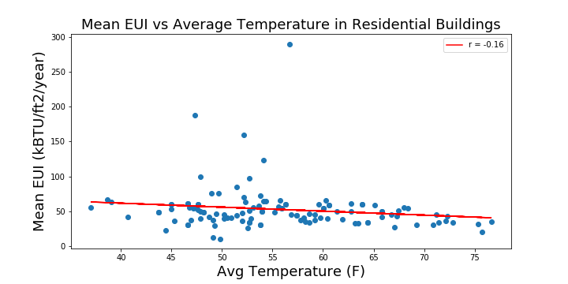
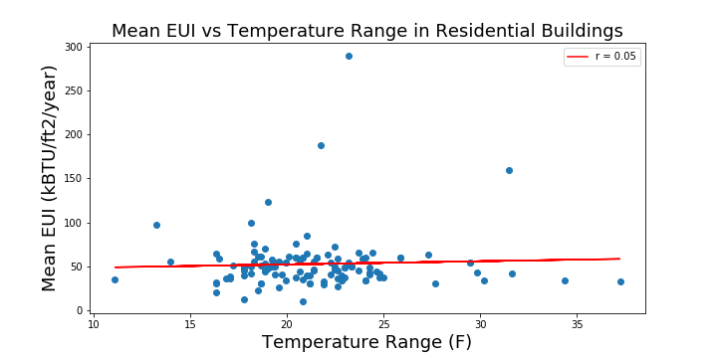
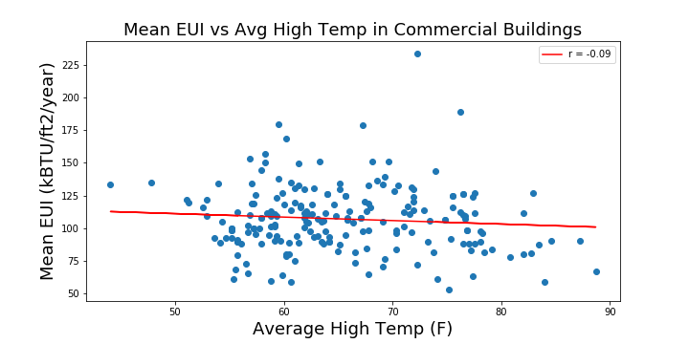
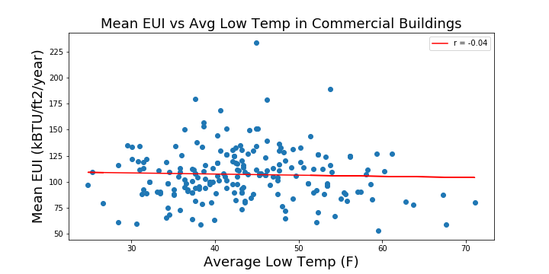
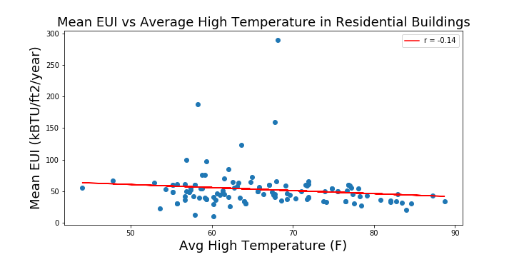
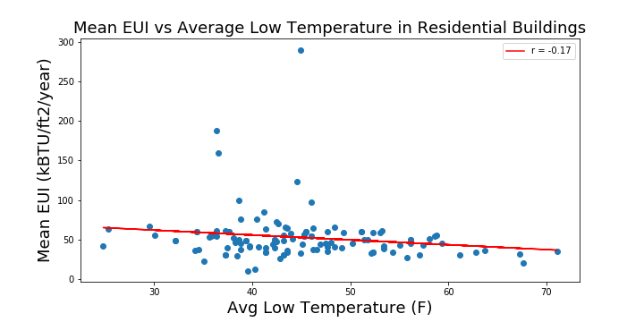
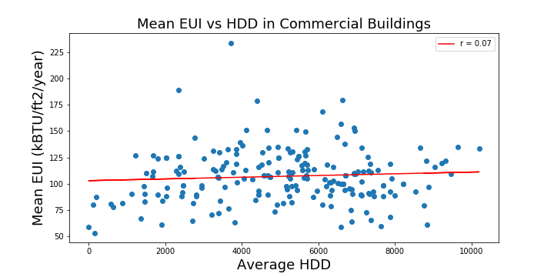
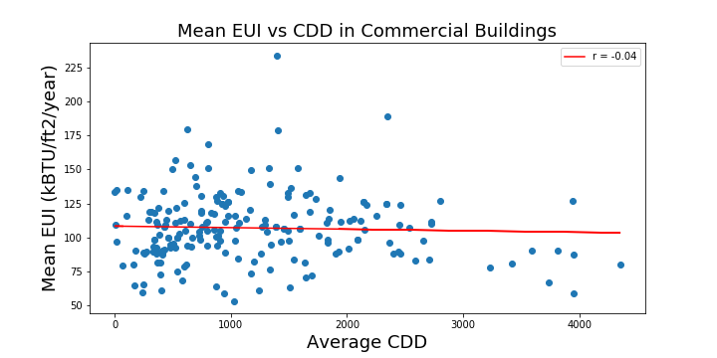
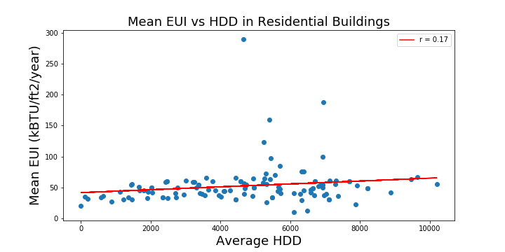
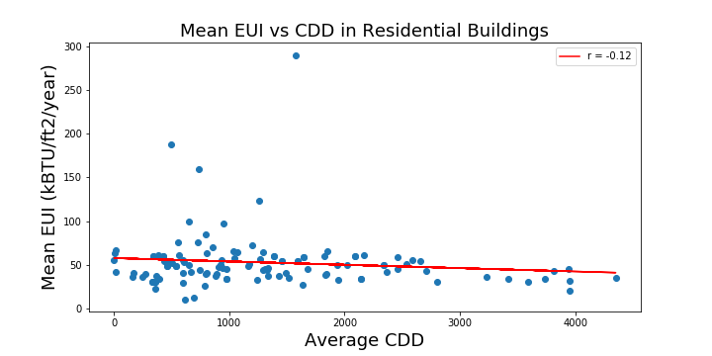
Commercial
Residential
Notes:
Steven:

Slide 9
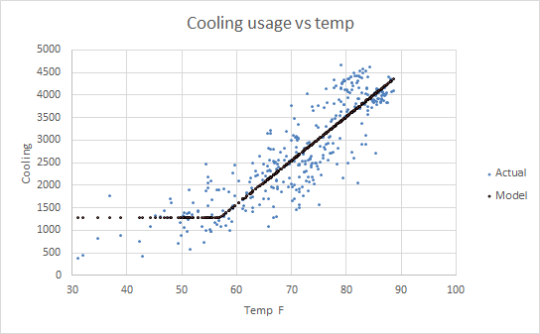
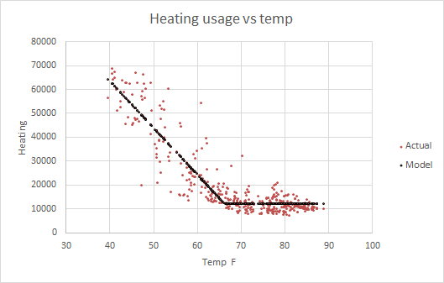
Define cooling/heating degree days
Cooling Degree Day =
number of degrees that a day’s average temperature is ABOVE 65℉, a measurement designed to quantify the demand for energy needed to COOL buildings
Heating Degree Day =
number of degrees that a day’s average temperature is BELOW 65℉, a measurement designed to quantify the demand for energy needed to HEAT buildings
Notes:
Adam:

Slide 10
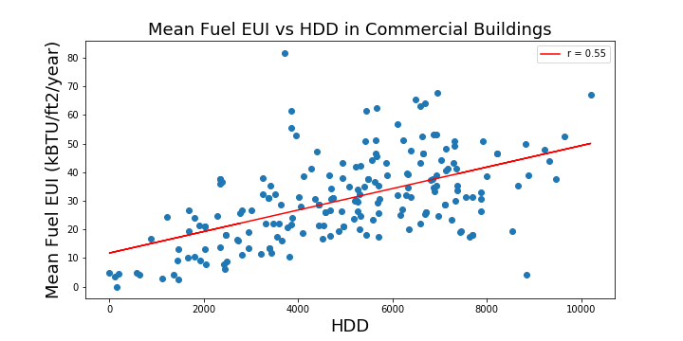
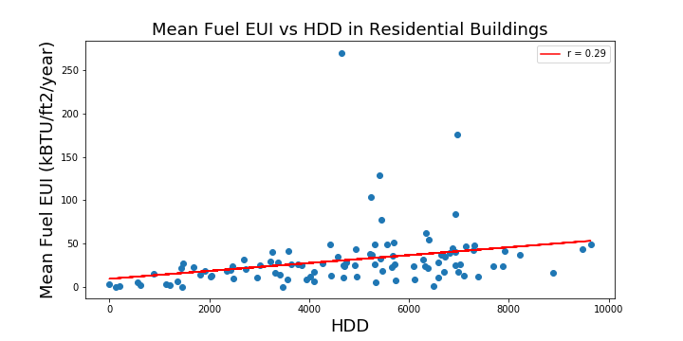
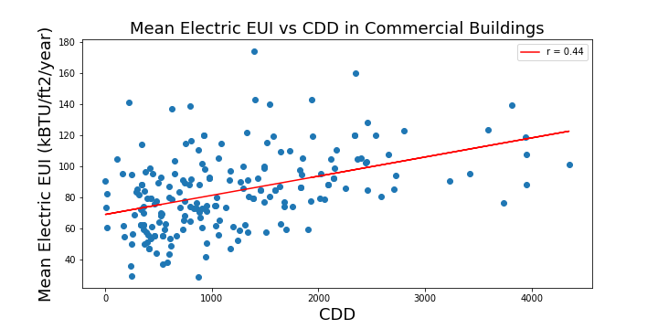
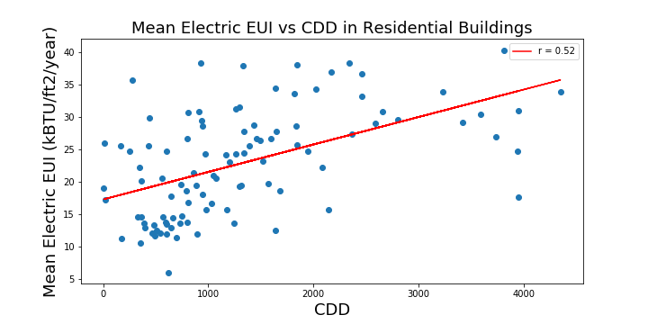
Commercial
Residential
Notes:
Steven:

Slide 11
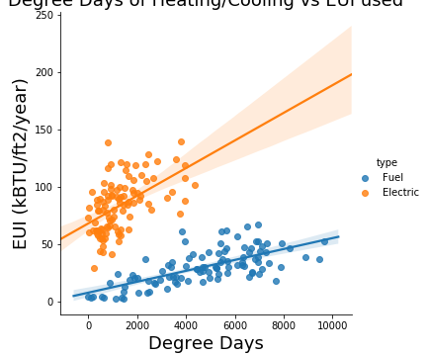
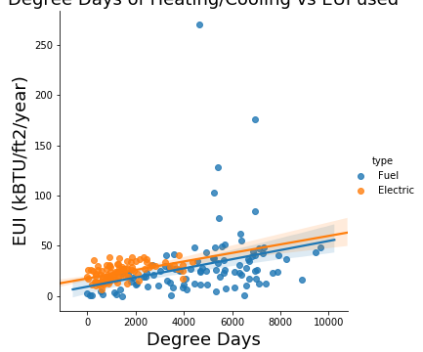
Further Analysis
Notes:
Steven:

Slide 12
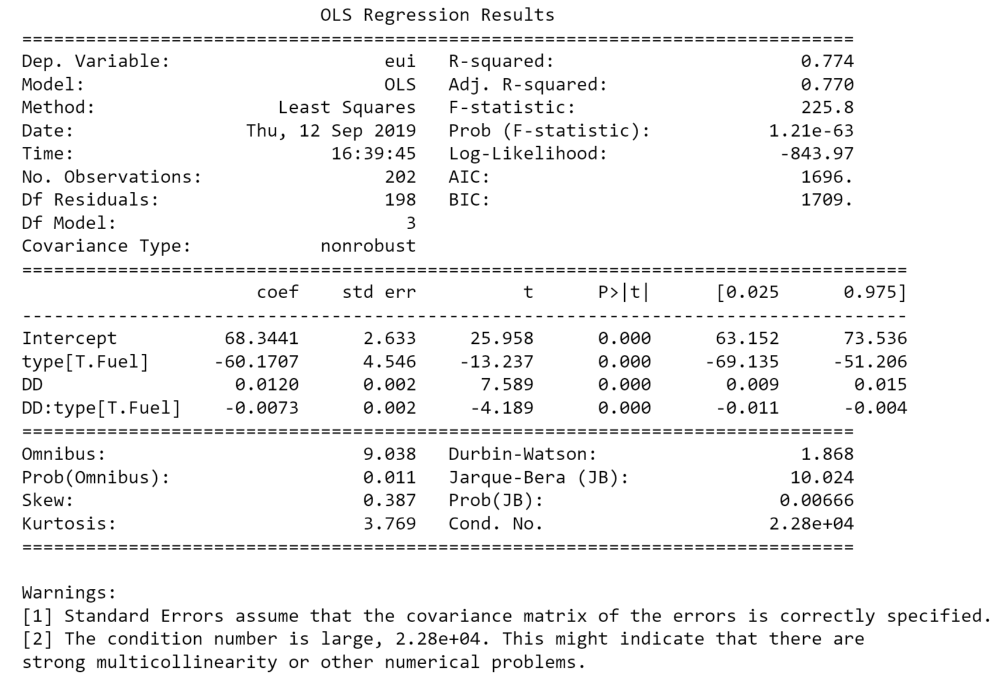
Notes:
Steven:

Slide 13
Analysis & Discussion
Low correlation between average temperature, min temperature, max temperature, and diurnal temperature range
Slightly higher correlation using degree days
Bar chart by DOE-defined climate zones is a little more clear visually
Best correlation using degree days and splitting EUI by electricity and fuel
Energy use increases at a higher rate with more cooling required vs more heating required
Notes:
Bobby

Slide 14
Post Mortem
Some APIs charge $
APIs aren’t always set-up how you wish they were for easy access to data in the desired format
With more time
Investigate effect of humidity on energy use in addition to temperature
Investigate other factors that affect building energy use such as building use type, (e.g. office vs. retail vs. hotel vs. restaurant)
Investigate residential energy use vs occupant density to see an energy use per person. This could show a per-person energy footprint of their home based on location. These results as seen vs population density could show energy footprint in urban vs suburban vs rural areas.
Notes:
Adam

Slide 15
Any questions?
This site uses data from Berkeley Lab’s Building Performance DatabaseTM, but is not endorsed or certified by Berkeley Lab.

